Slide 1

Deloitte/BT Quant Competition
Sebastian Coroian
Octavian Rentea
Team 7

Slide 2
General Overview of the models & findings
Model I | Model II
Description: The first model is an autoregressive model with a LAG of 2 commonly used in DR prediction. This model shows the effect of previous default stages on the DR. | Description: The second model is a multilinear regression with Industrial Production Index(IPI), Consumer Wage(CW) and RON/MDL as the predictor variables.
Type: AR(2) | Type: MLR(3 predictors)
Characteristics: Observations: 128 R^2: 0.973 Durbin-Watson: 2.008 Data split: 80% Train, 20% Predict | Characteristics: Observations: 114 R^2: 0.752 Durbin-Watson: 2.210 Data split: 80% Train, 20% Predict

Slide 3
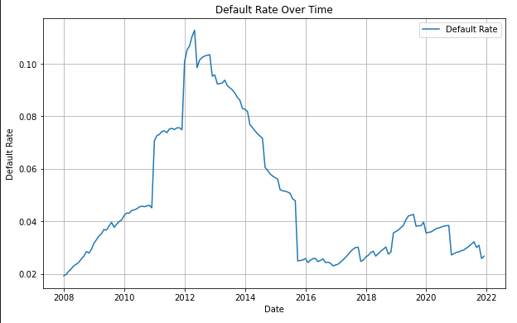
Default Rate calculation
In order to compute the Default Rate for the portfolio we did the following:
We created a new column within the dataset that “shifts” the default flag 12 months back
We summed up all the clients that would be in the default state in the next 12 months at each observation date and divided them by the total number of customers at the observation date

Slide 4
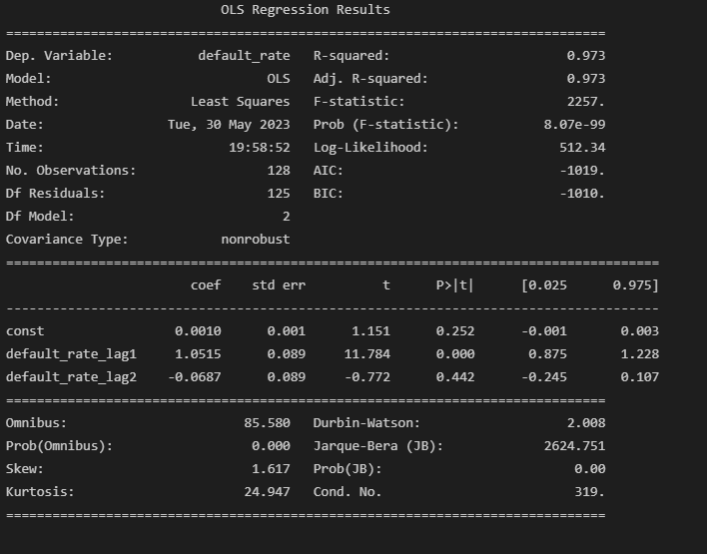
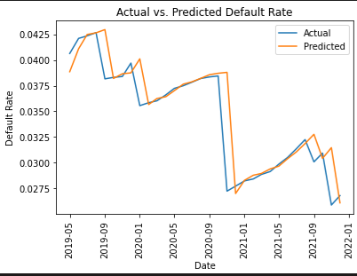
First model presentation & reasoning
In order to predict the forward looking Default Rate we choose to use an AR(2), to illustrate the effect that different stages of defaulted customers(early-stage, late-stage) will have on the final default state.

Slide 5
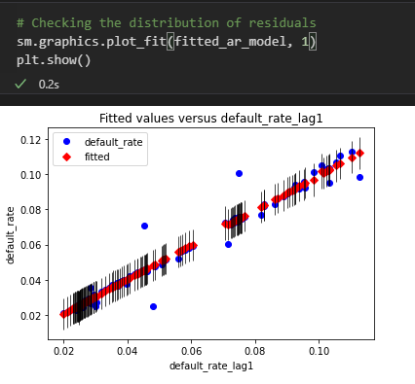
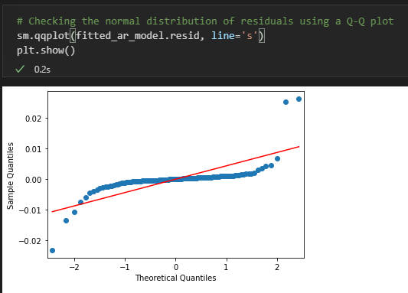
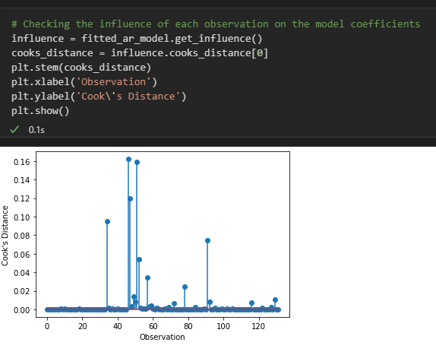
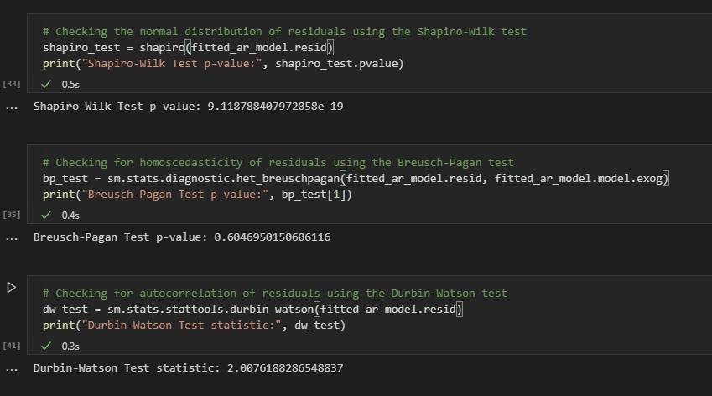
First model validation tests

Slide 6
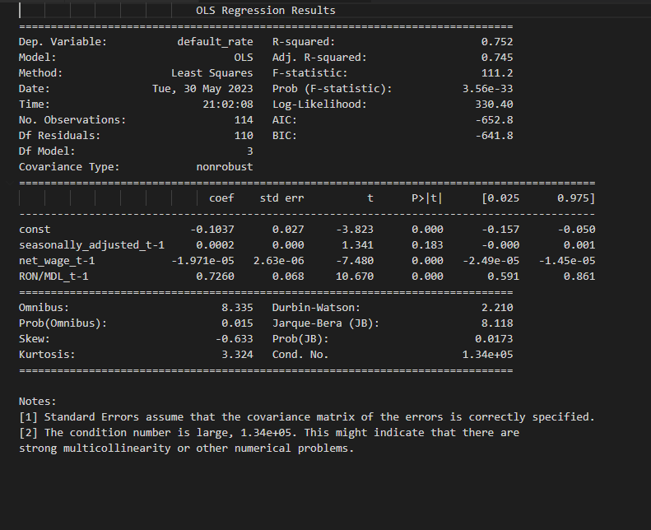
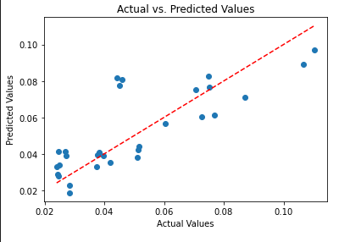
Second model presentation & reasoning
The purpose of the second model is to illustrate the effect that the seasonally adjusted economic factors: Industrial Production Index, Consumer Wage and the exchange rate for RON/MDL have on the DR.
Data timeframe: 2010-2021

Slide 7
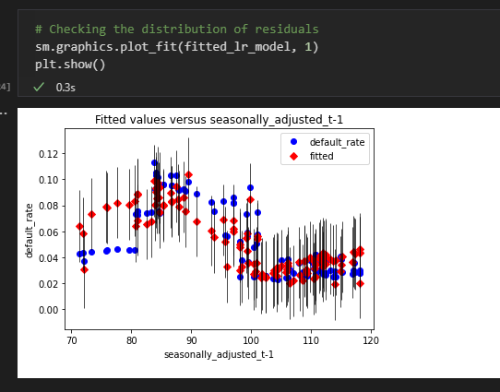
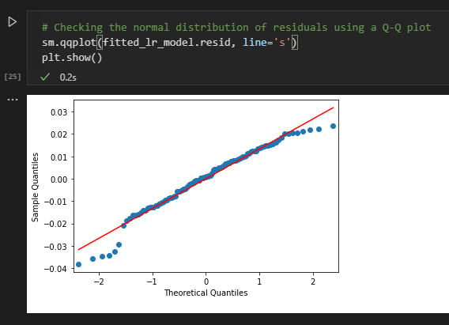
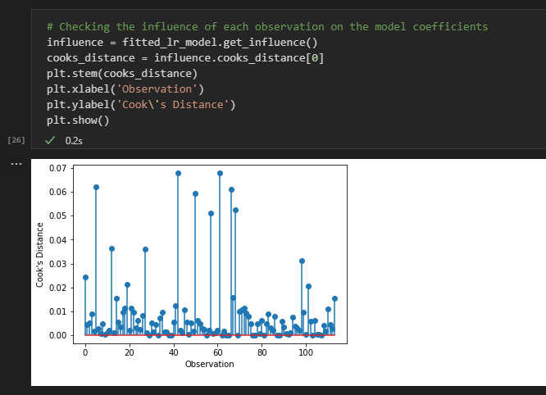
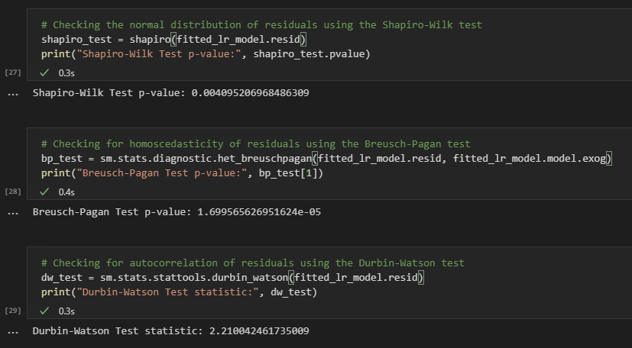
Second model validation tests

